Slide 1
Team Meeting November 1
Group 1 – 5:15 to 5:55pm
On Ice: : Shay, Dante, Kailyn, Logan H., Os
Board Room LM, NM, GM, ST, ET
Pub 21 HH, AD, AB,MB, BD
Group 2 - 5:55 to 6:35pm
On Ice: Logan M., Nathaniel, Gianna, Sam, Ella
Board Room HH, AD, AB,MB, BD
Pub 21 SM, DG, KM, LH, OT
Group 3 – 6:35 to 7:15pm
On Ice: Hudson, Alex, AJ, Mark, Braden
Board Room SM, DG, KM, LH, OT
Pub 21 LM, NM, GM, ST, ET
PUB 21 - PIZZA
7:30 – 8:00 pm
2006 Tier 2 White

Slide 2
30 Minutes
What is fun about hockey?
Team Expectations – Game Day, Selfish Penalties
Player Expectations – Focused, Willingness to listen & learn, Do my best to execute!
Team Website – What’s available?
Game Tape
Always ask questions !
Board Room

Slide 3
35 Minutes
D – Zone Faceoff
Penalty Kill – Forecheck, D - Zone Coverage
Power Play – Set Up and Options
Attack Triangle
Always ask questions !
Whiteboard
Pub 21

Slide 5
Link to Cougars Site
Penalty Kill Tips
D Zone : Box + 1
GAME VIDEO

Slide 6
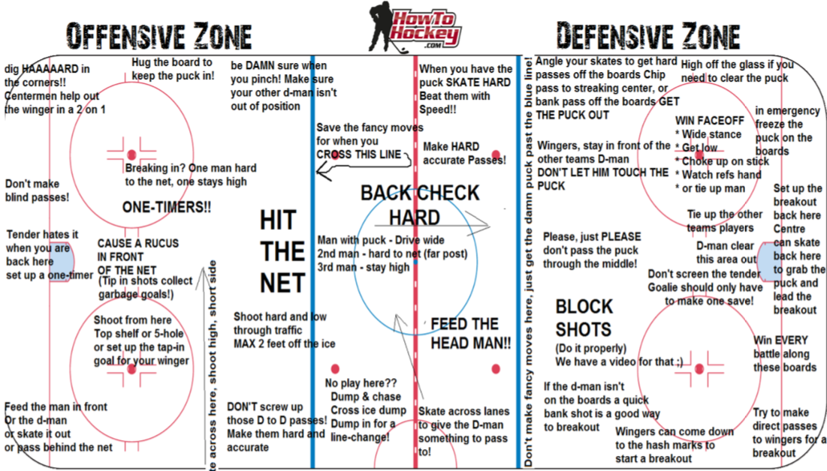

Slide 7
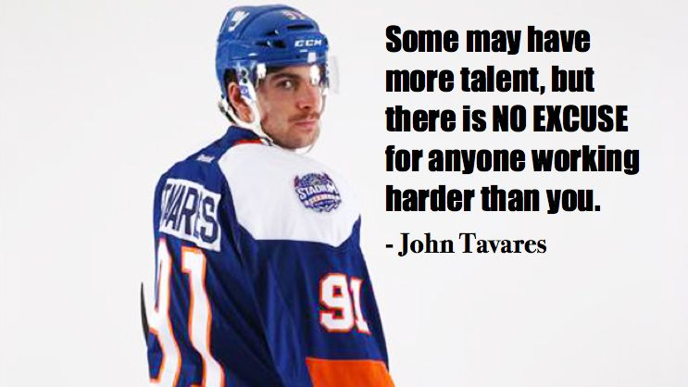

Slide 8
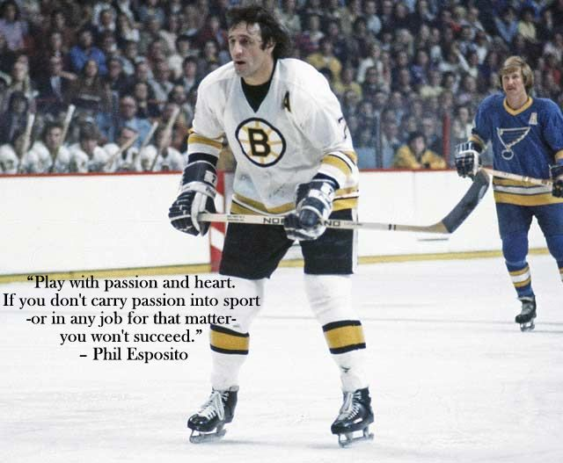

Slide 9
